Slide 1
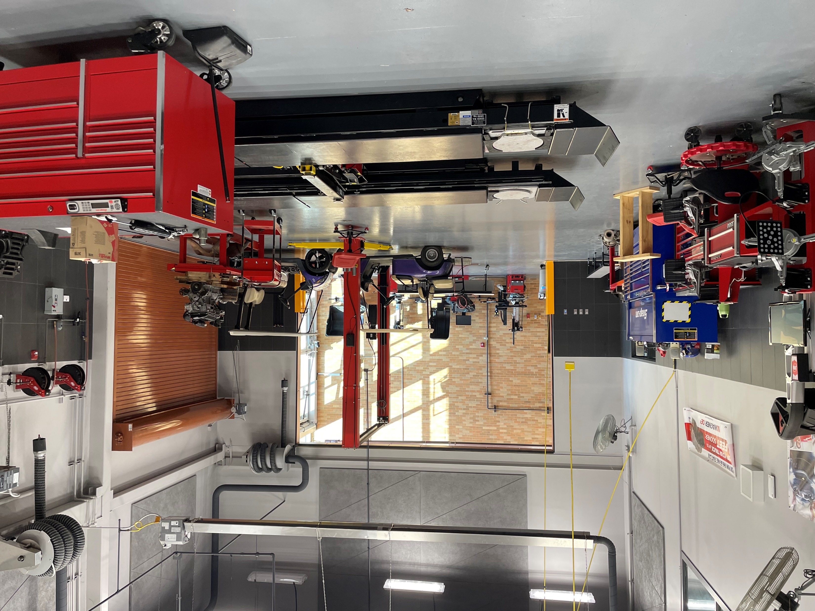
Automotive (Auto Technology)
Statewide Program of Study
Transportation, Distribution, and Logistics Career Cluster
The Transportation, Distribution, and Logistics Career Cluster focuses on careers in planning, management, and movement of people, materials, and goods by road, pipeline, air, rail, and water. It also includes related professional support services such as transportation infrastructure planning and management, logistics services, mobile equipment and facility maintenance.
The Automotive (Auto Tech) program of study teaches CTE learners how to repair automobiles and service various types of vehicles. CTE learners may learn to collect payment for services or supplies and perform typical vehicle maintenance procedures such as lubrication, oil changes, installation of antifreeze, or replacement of accessories like wiper blades or tires.
Work-Based Learning and
Expanded Learning Opportunities
Exploration Activities | Work-Based Learning Activities
Join SkillsUSA | Work at a local automotive repair or body shop
Secondary Courses for High School Credit
1 Automotive Basics
2 Automotive Technology I
3 Automotive Technology II
4 Career Preparation I
Industry-Based Certifications
Automotive Service Excellence certifications (multiple)
Postsecondary Opportunities
Associates Degrees
Autobody/ Collision and Repair Technology/ Technician
Medium/Heavy Vehicle and Truck Technology/ Technician
Mechanical Engineering/ Mechanical Technology/ Technician
Bachelor’s Degrees
Mechanical Engineering/ Mechanical Technology/ Technician
Master’s, Doctoral, and Professional Degrees
Mechanical Engineering
SMHS Automotive Technology Shop
Aligned Occupations
Occupations | Median Wage | Annual Openings | % Growth
Automotive Body and Related Repairers | $40,144 | 1,456 | 25%
Automotive Service Technician and Mechanics | $38,459 | 5,557 | 18%
Successful completion of the Automotive program of study will fulfill requirements of the Business and Industry endorsement. Revised – August 2022

Slide 2
Automotive Course Information
COURSE NAME | SERVICE ID | PREREQUISITES | COREQUISITES
Automotive Basics | 13039550 (1 credit) 6806 | None | None
Automotive Technology I | 13039600 (2 credits) 6802 | Automotive Basics | None
Automotive Technology II | 13039700 (2 credits) 6803 | Automotive Technology I | None
Career Preparation I | 12701300 (2 credits) 6910 | None | None
FOR ADDITIONAL INFORMATION ON THE TRANSPORTATION, DISTRIBUTION, & LOGISTICS CAREER CLUSTER,
PLEASE CONTACT: CJ Odam, SMCISD CTE Coordinator cj.odam@smcisd.net
San Marcos CISD does not discriminate on the basis of race, color, national origin, sex, disability or age in its programs or activities and provides equal access to the Boy Scouts and other designated youth groups. The following person has been designated to handle inquiries regarding the nondiscrimination policies: Stephanie Munoz ; 631 Mill St, San Marcos, TX 78666 ; 512-393-6700 ; stephanie.munoz@smcisd.net
Further nondiscrimination information can be found at smcisd.net/cte

